Slide 1
Quick Computer Architecture Overview
Most slides stolen from my Penn professor, Joe Devietti. He’s a cool guy. Thanks Joe!

Slide 2
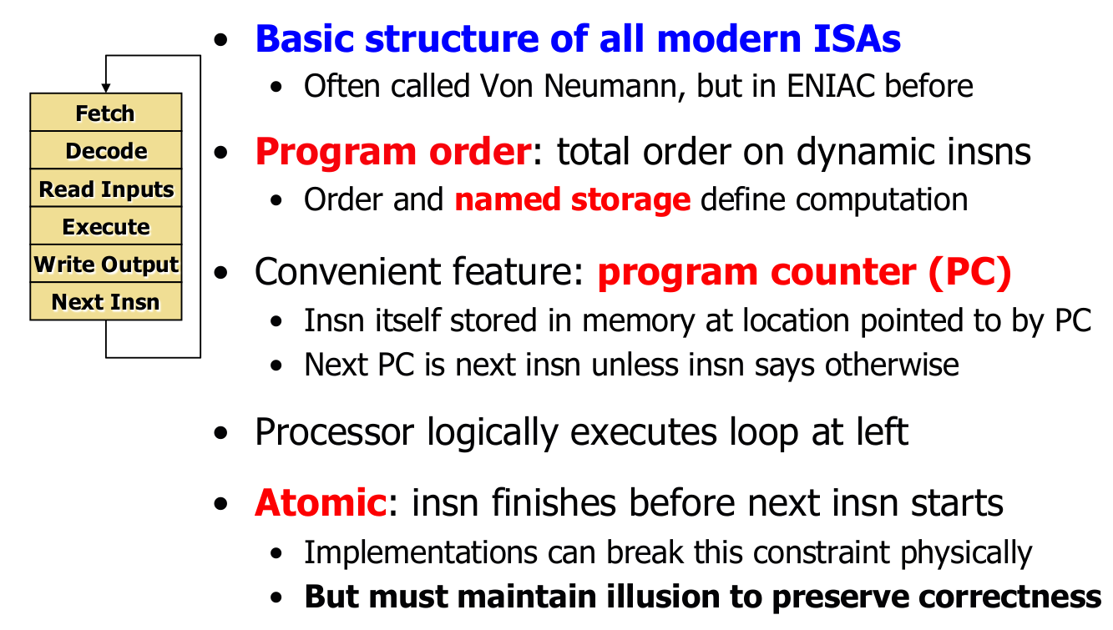

Slide 3
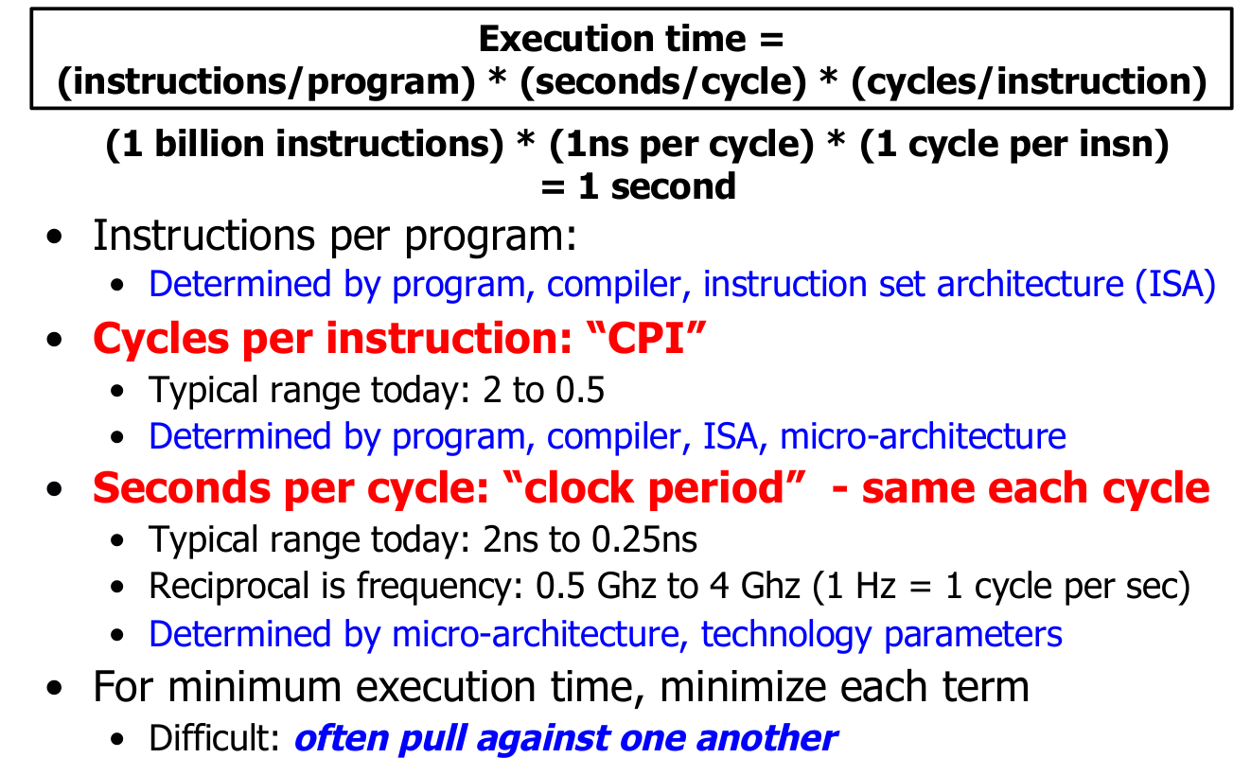

Slide 4
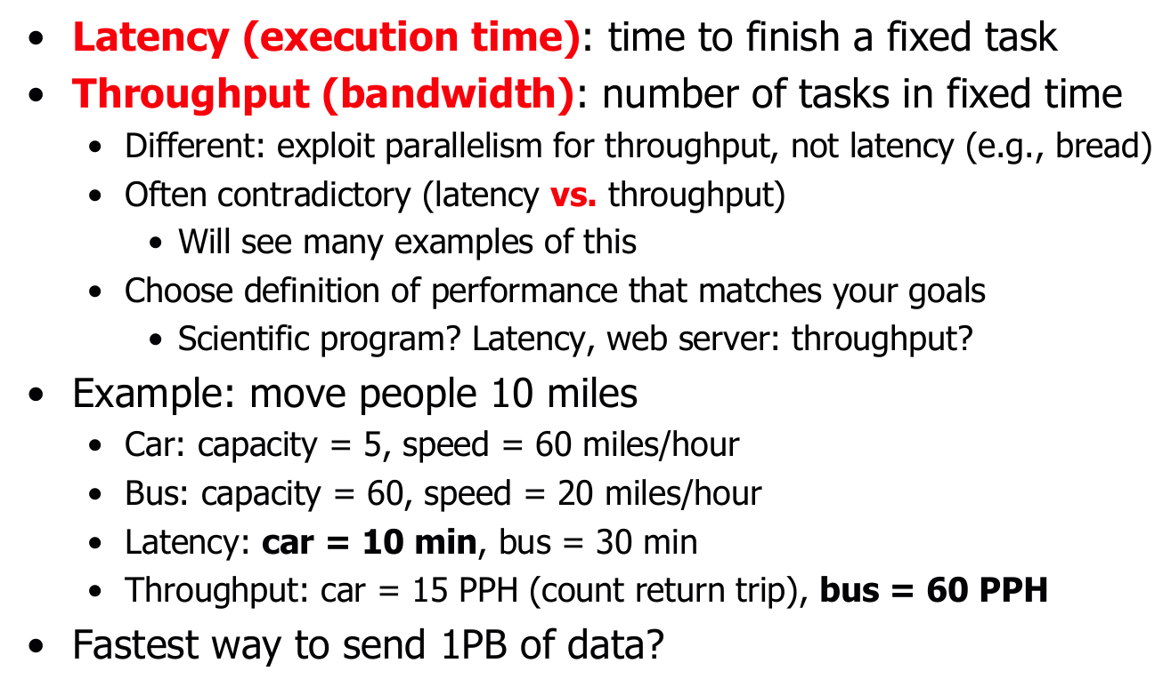

Slide 5
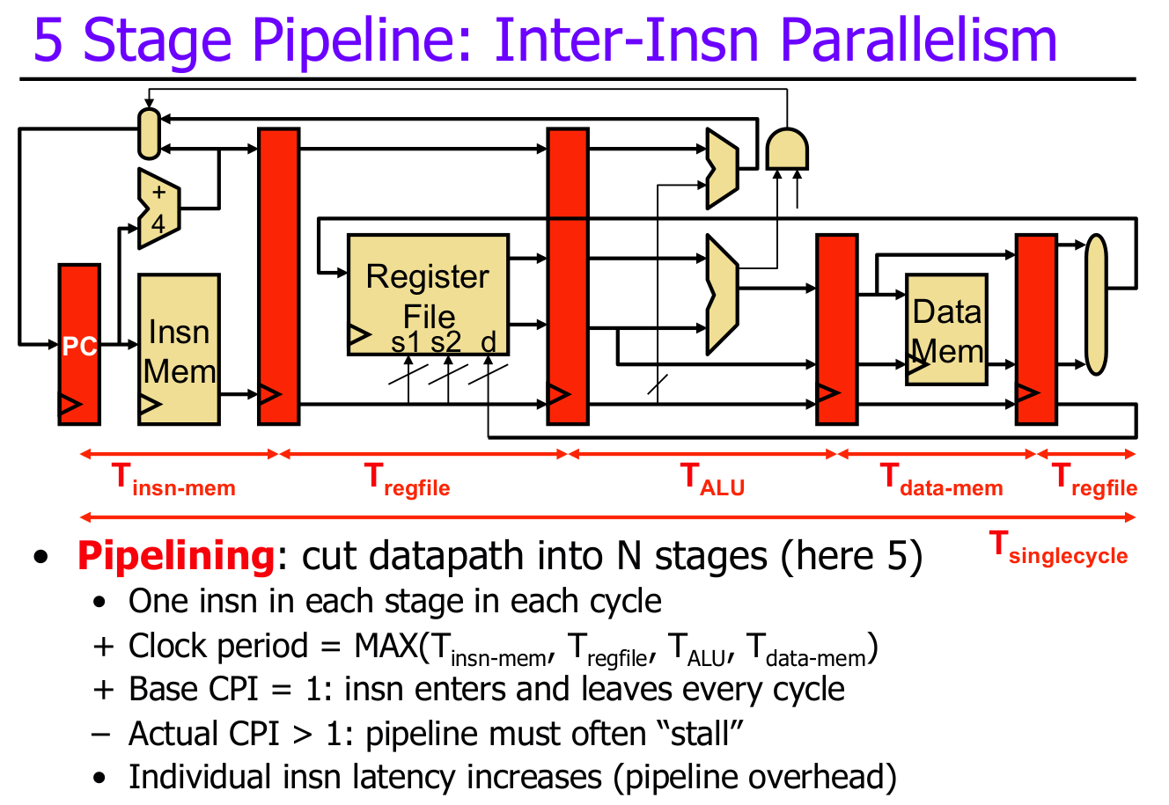

Slide 6
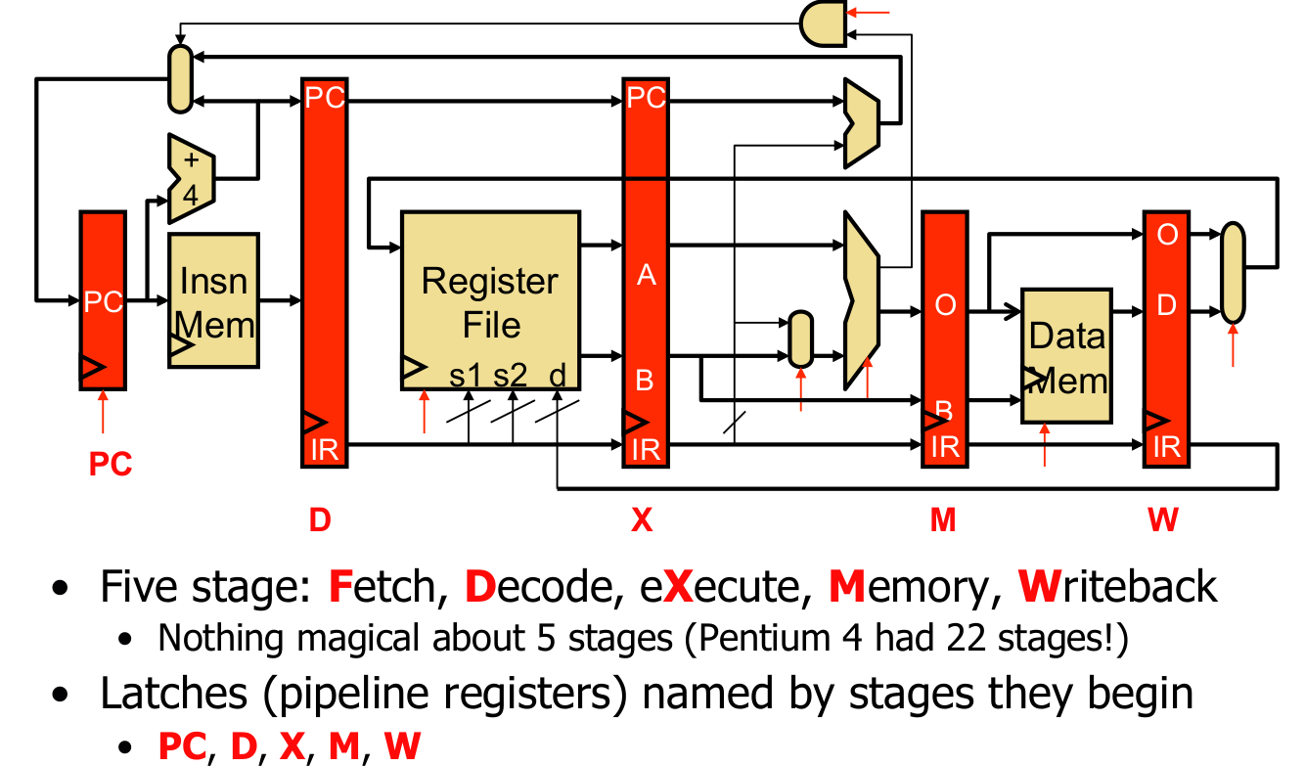

Slide 7
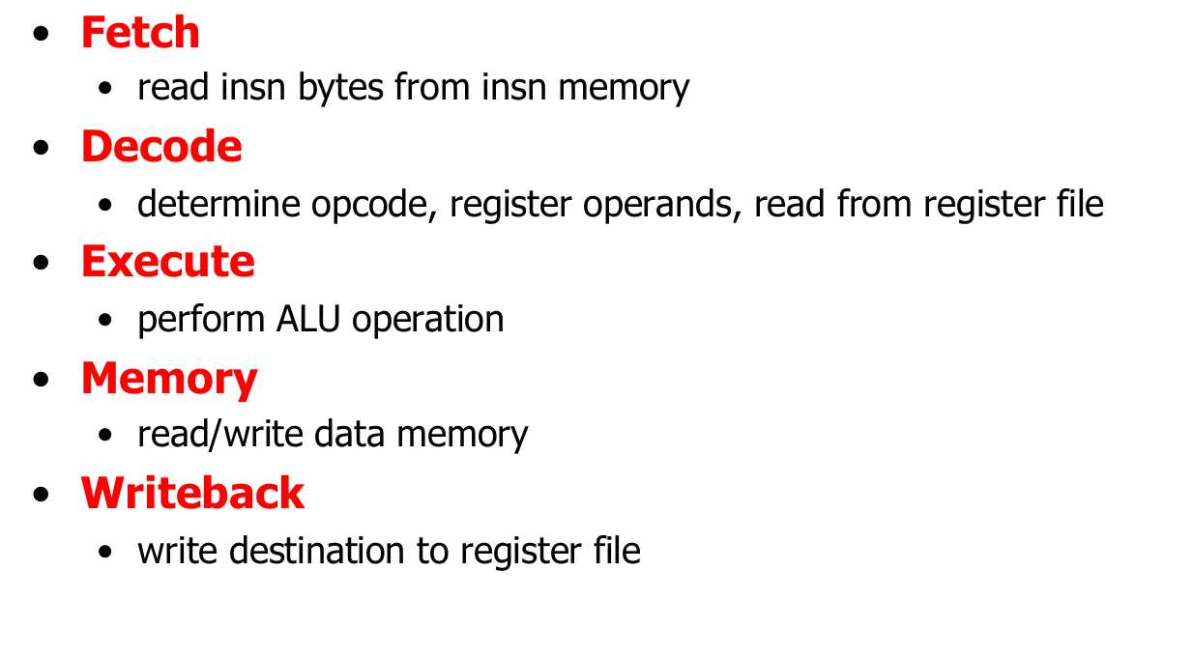

Slide 8
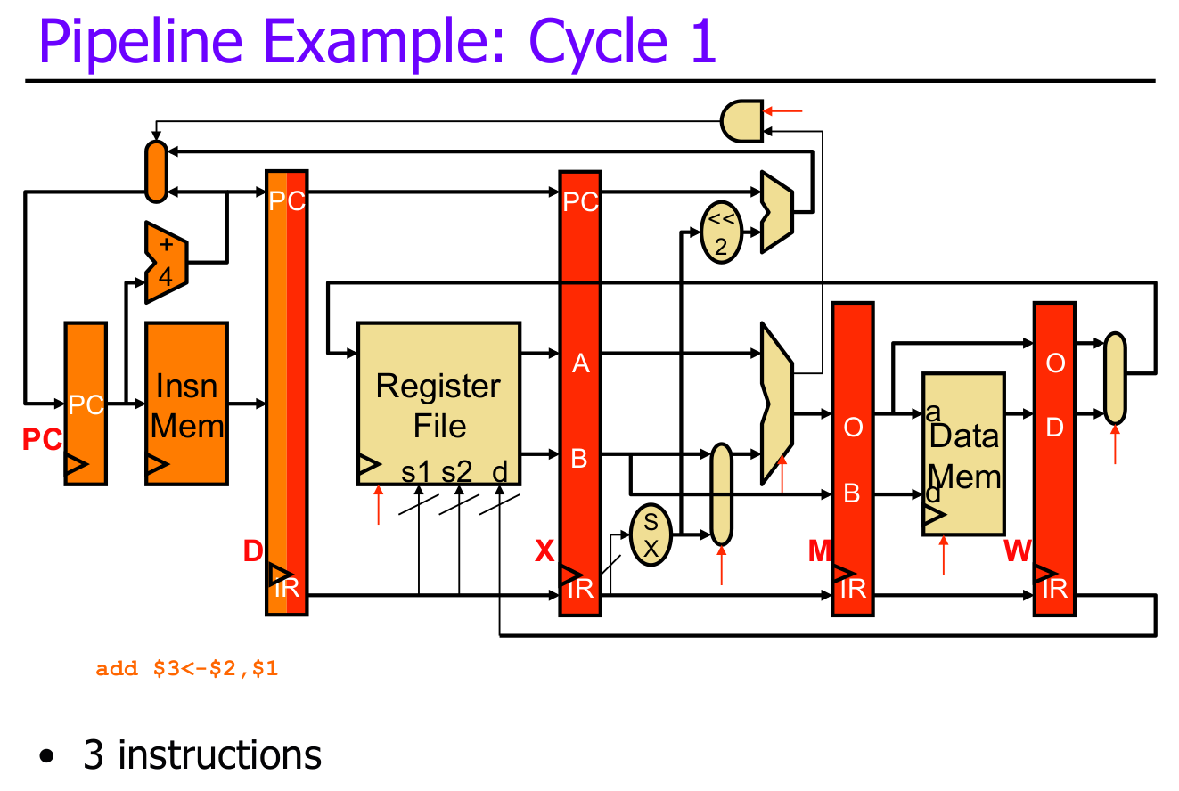

Slide 9
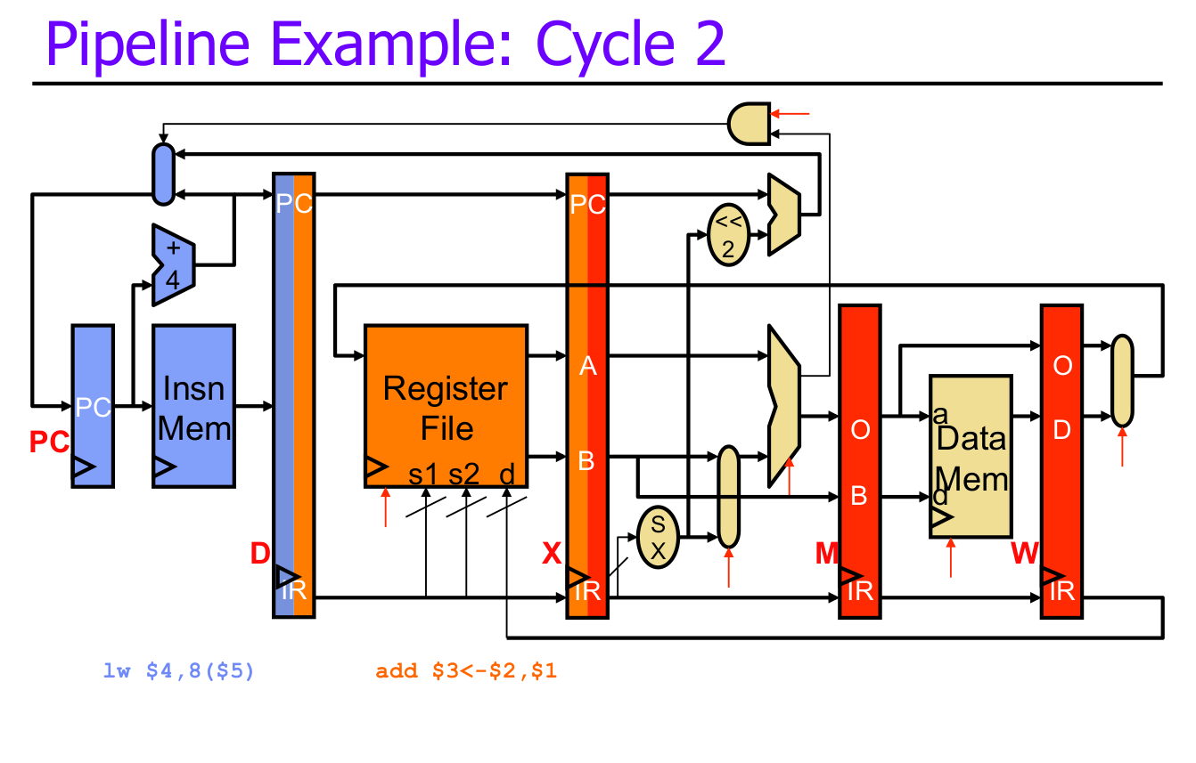

Slide 10
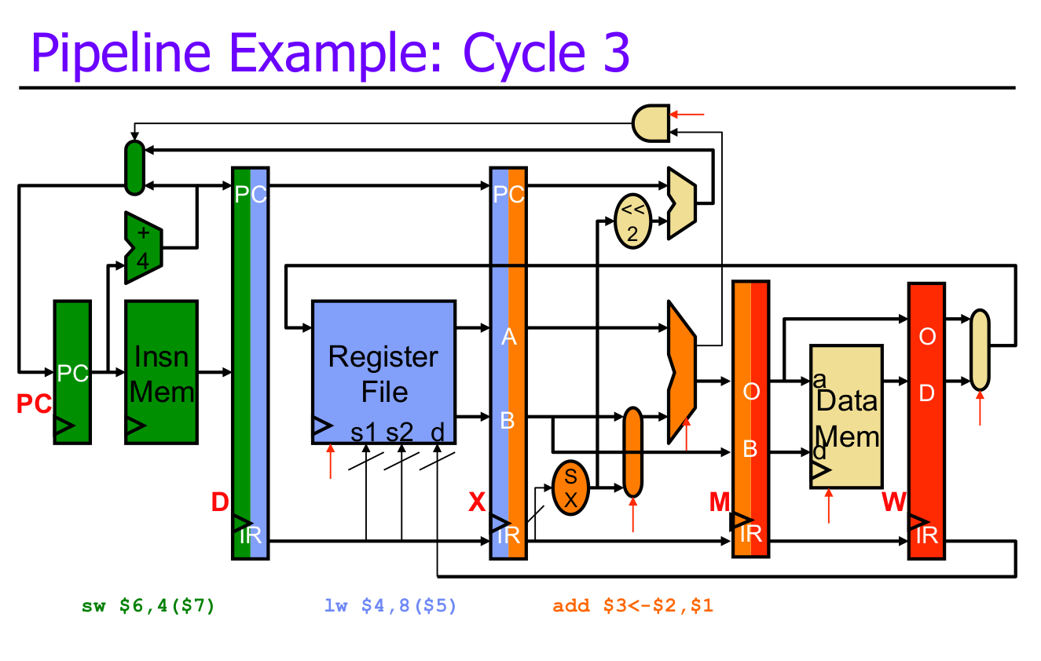

Slide 11
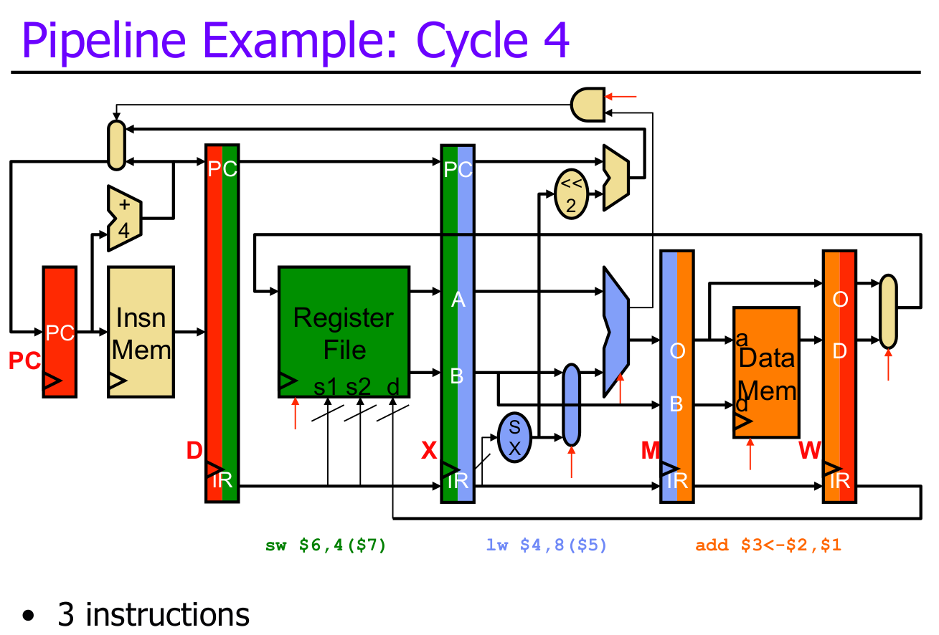

Slide 12
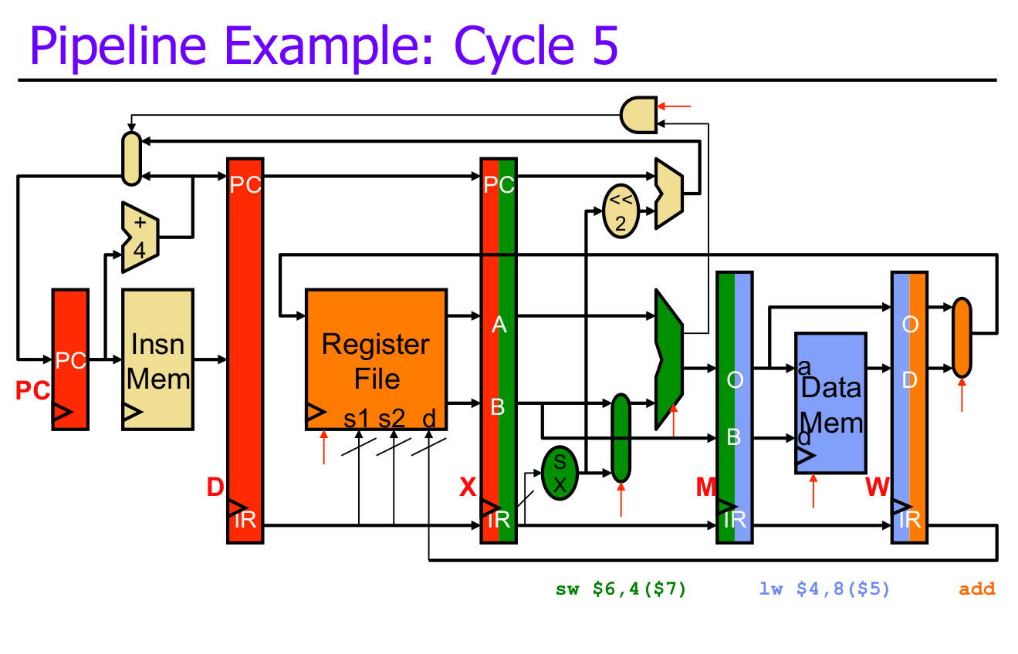

Slide 13
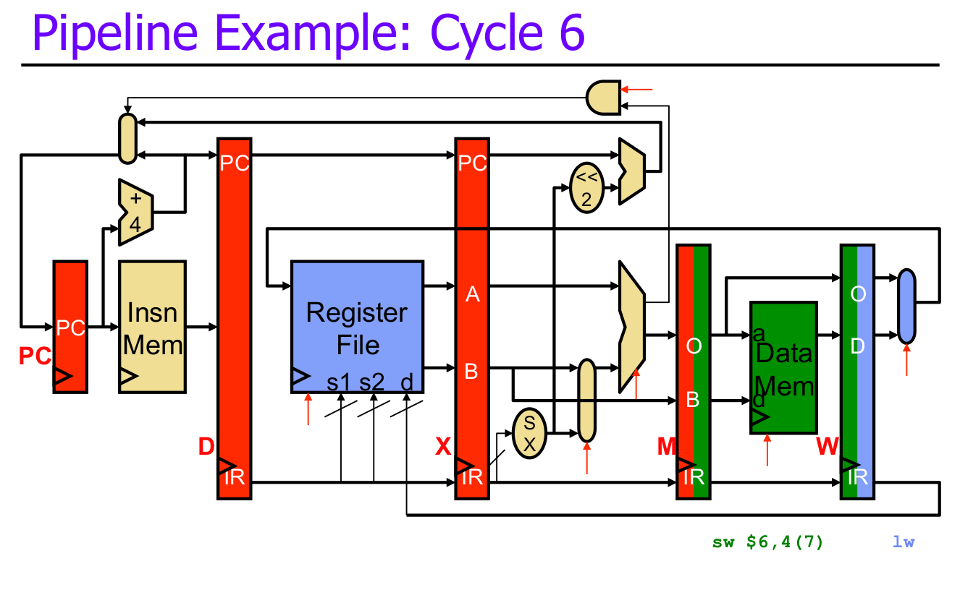

Slide 14
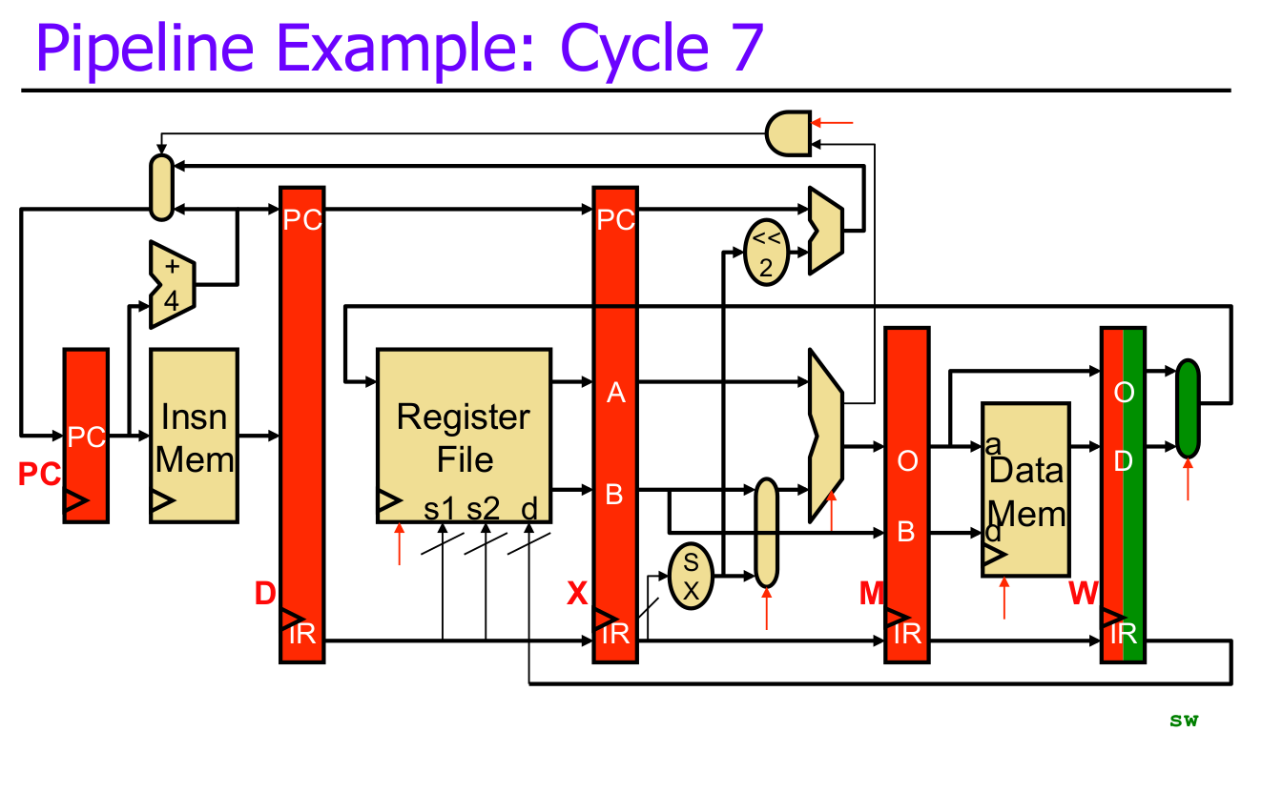

Slide 15
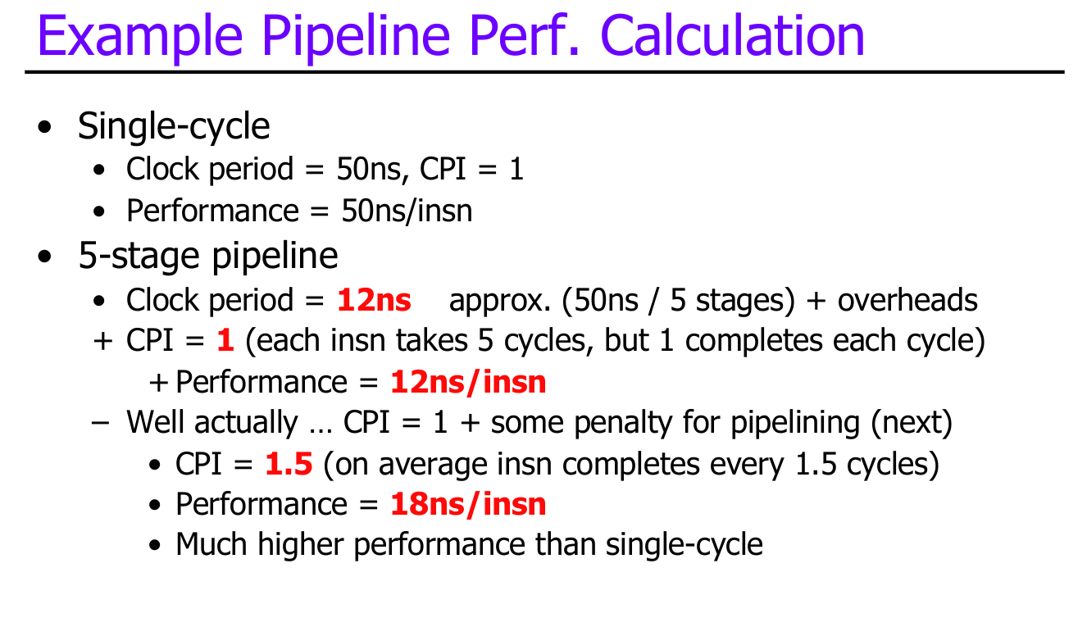
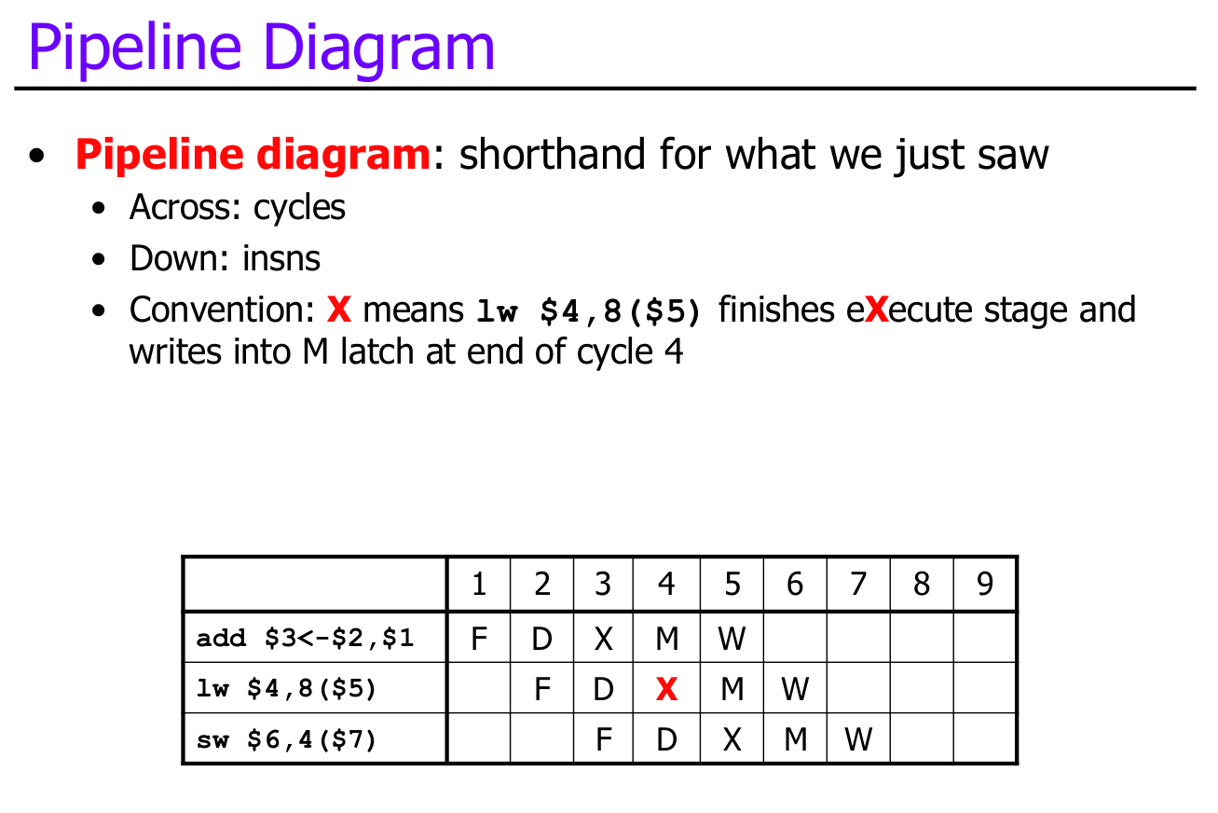

Slide 16
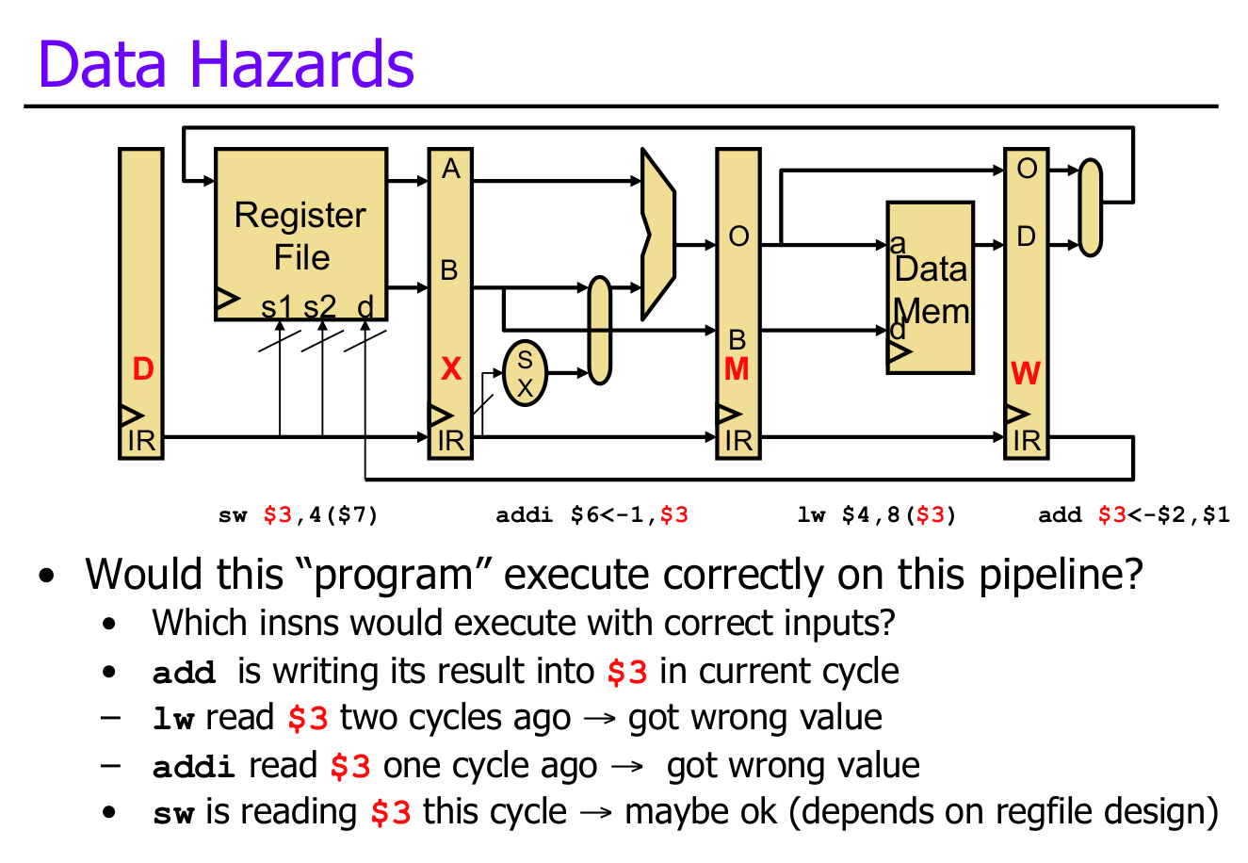

Slide 17
Continued
Do we see any other problems?

Slide 18
Solutions
Branch Prediction
Solves penalties from not taking correct branches
Tries to predict what branch to take with a high accuracy
Caching
Solves slow memory operations
Series of small memory “caches” closer to the processor with lower latency

